Slide 1
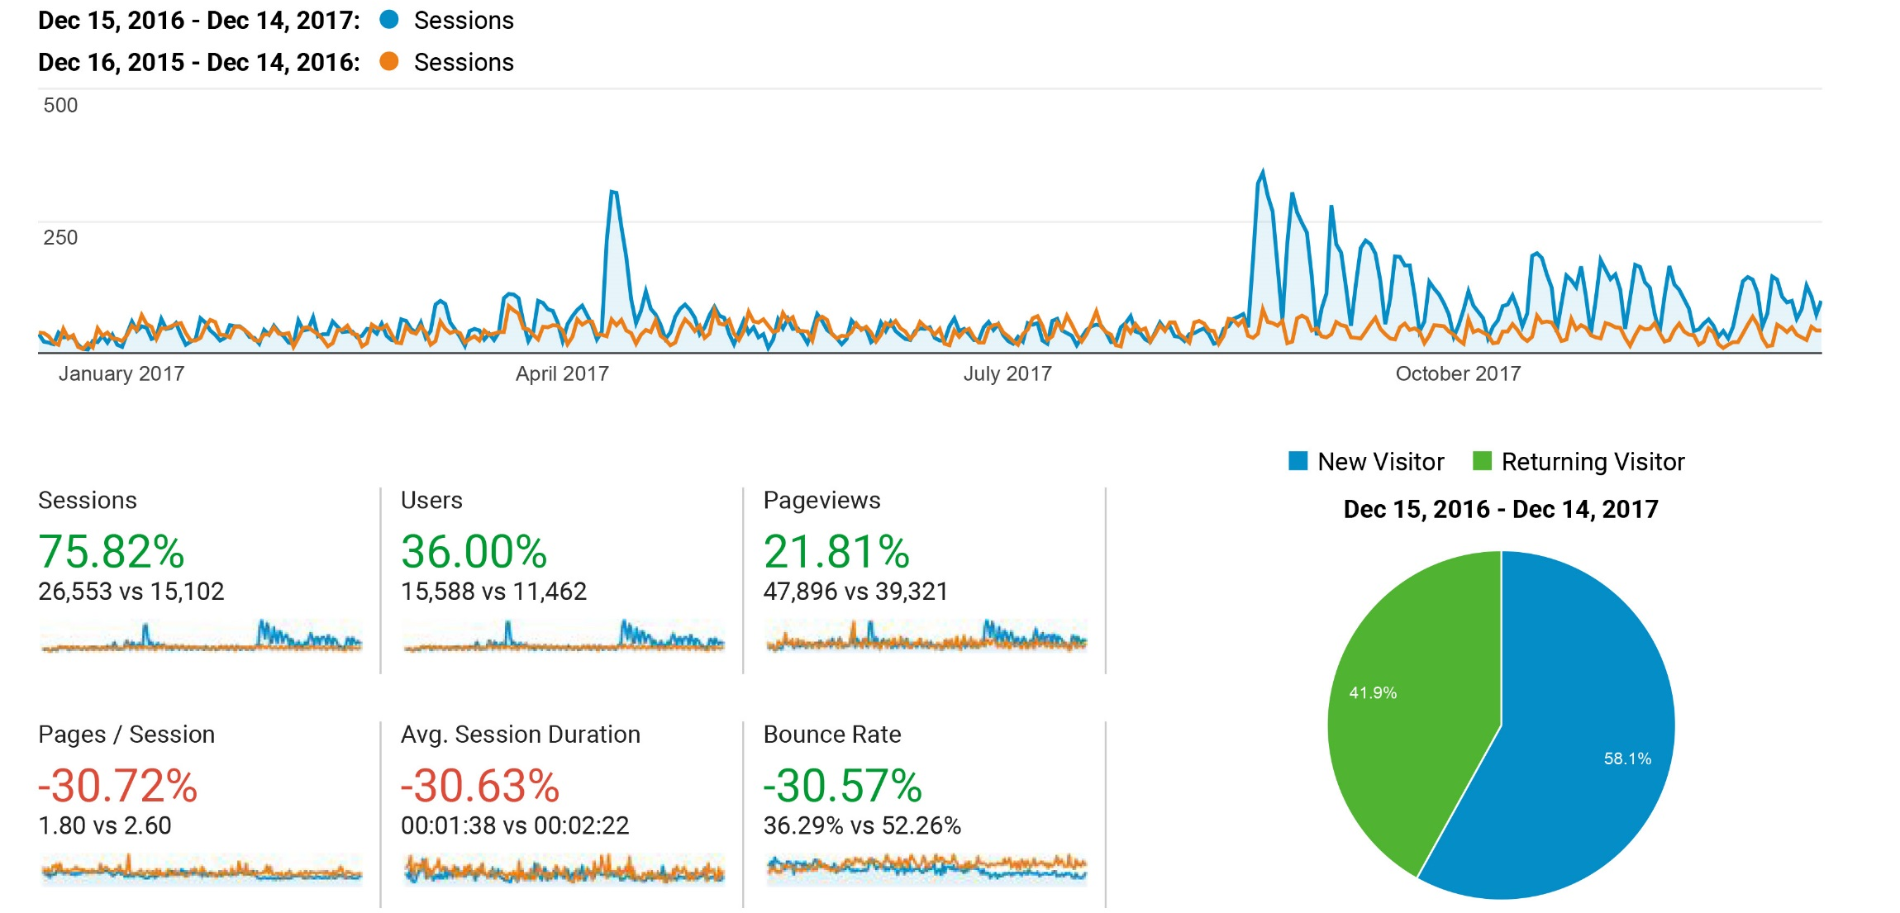
Online Audience Overview

Slide 2
Online Audience Drilldown
Top Countries % of traffic in 2017/2016 % Change between 2016-2017 United States 90.66% / 77.10% +106.75%
India 1.42% / 0.76% +228.70%
Russia 1.03% / 11.04% -83.57% Uganda 0.59% / 0.03% +3,825.00%
Philippines 0.45% / 0.33% +138.00%
Note: Canada, Pakistan, China, Malaysia, and Nigeria round out your top 10

Slide 3
Online Audience Drilldown
Top Cities % of traffic in 2017/2016 % Change between 2016-2017
Ames 50.68% / 17.06% +422.44%
Des Moines 2.92% / 3.64% +41.35%
Not Reporting 1.80% / 2.34% +34.75%
West Des Moines 1.23% / 1.14% +90.12%
Cedar Rapids 0.77% / 0.82% +65.32%
Iowa City 0.76% / 1.57% -14.35%
Omaha 0.69% / 1.36% -11.22%
Boone 0.65% / 0.13% +810.53%
Kampala 0.59% / 0.03% +3,800.00%
New York 0.54% / 0.81% +17.07%
Ankeny 0.52% / 0.75% +23.01%
Urbandale 0.48% / 0.26% +217.50%
Chicago 0.44% / 0.72% +9.26%
Cedar Falls 0.39% / 0.46% +50.72%
Minneapolis 0.35% / 0.34% +78.85%

Slide 4
Online Audience Drilldown
Top Browsers Top Platforms Chrome 36.59% Desktop 96.19% Edge 25.35% Tablet 3.43% IE 13.66% Mobile 0.37% Firefox 13.57% Safari 9.54% Opera 0.88%

Slide 5
Online Audience Drilldown
Top Mobile Devices – including tablets/ipads
iPad 64.59% Microsoft Windows RT Tablet Windows RT Tablet 16.82%
Microsoft Windows RT Tablet 8.4% Not Reporting 4.95% Microsoft Xbox 4.15% BlackBerry KBD 0.40% BlackBerry Z10 0.32%

Slide 6
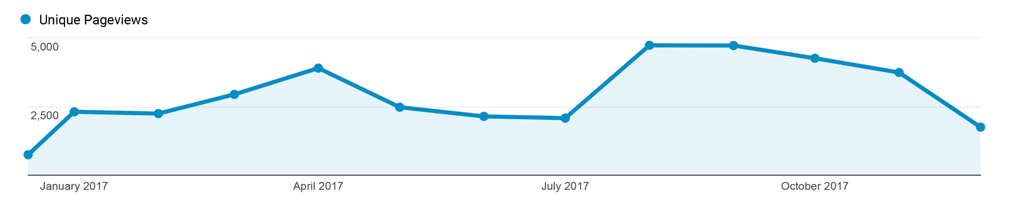
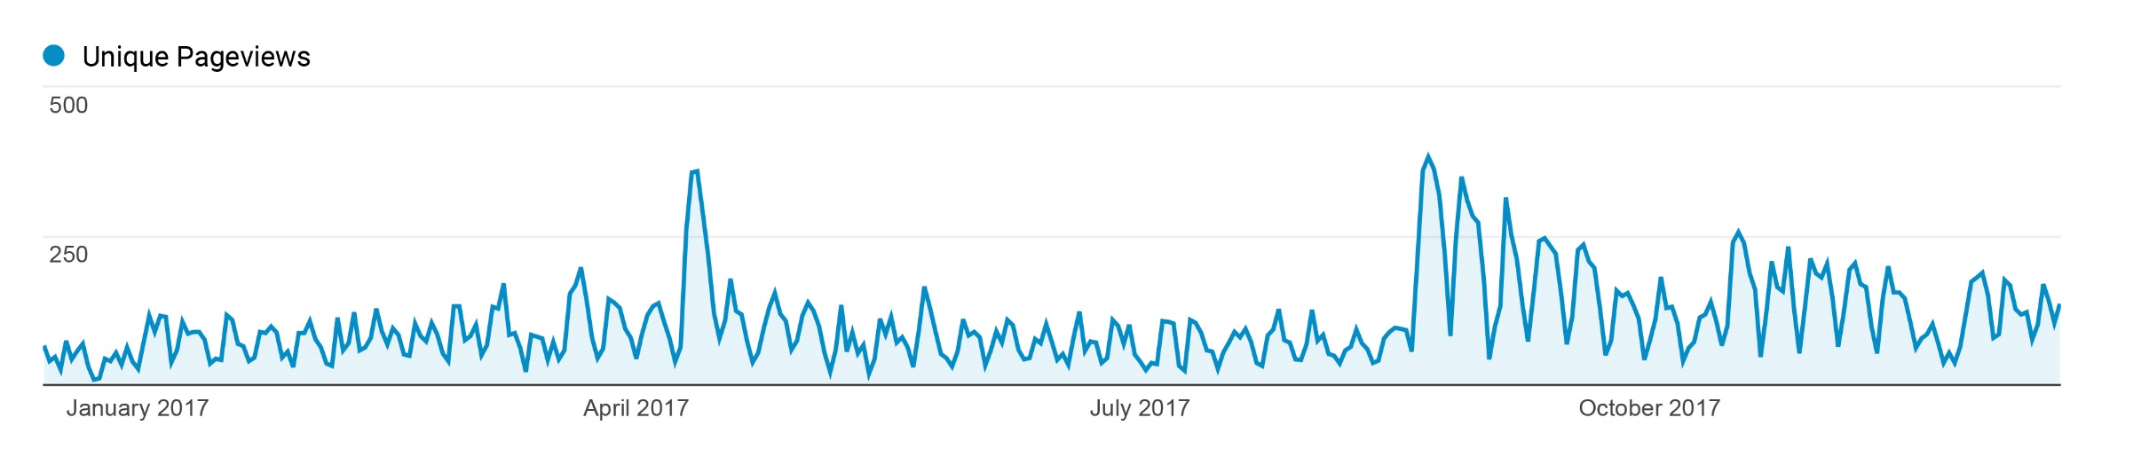
Online Behavior Overview
August saw the most traffic.
Weekly traffic varies greatly. Still more weekday traffic than weekend traffic.

Slide 7
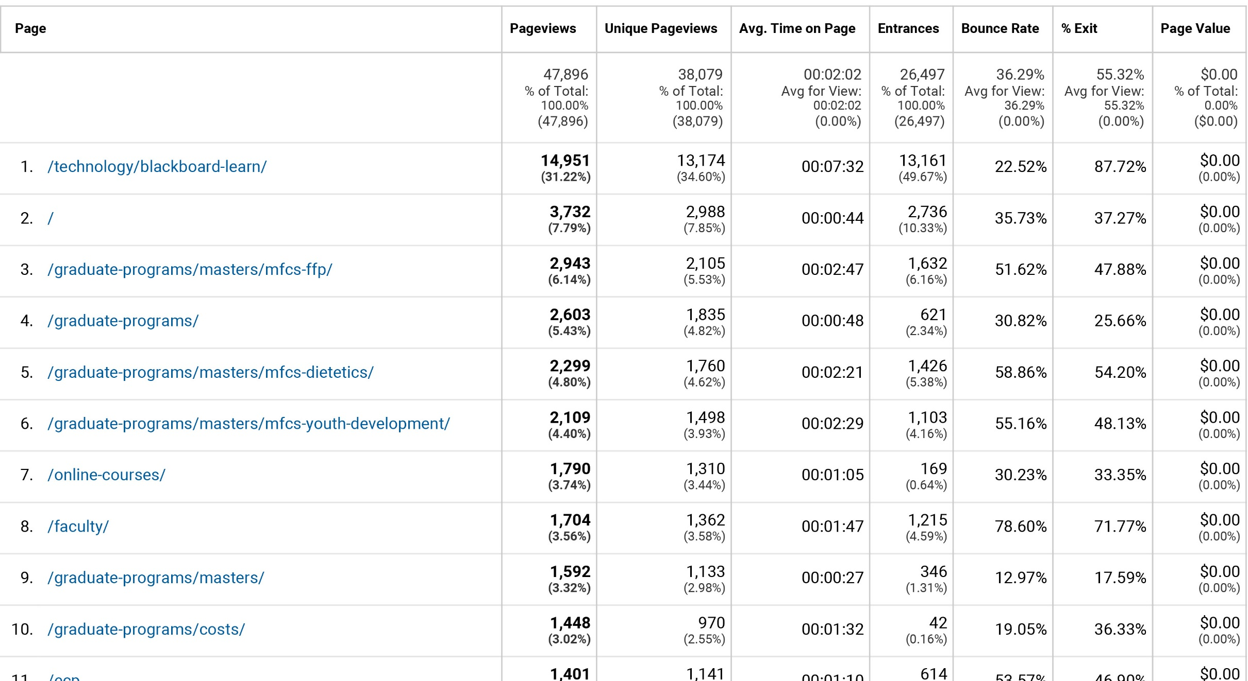
Online Most Visited Pages

Slide 8
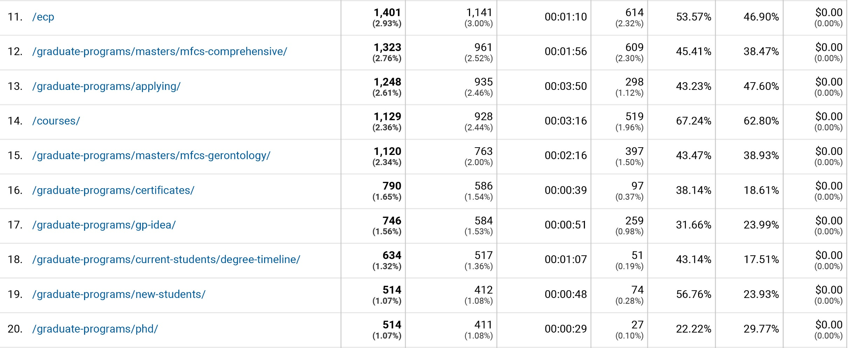
Online Most Visited cont.

Slide 9
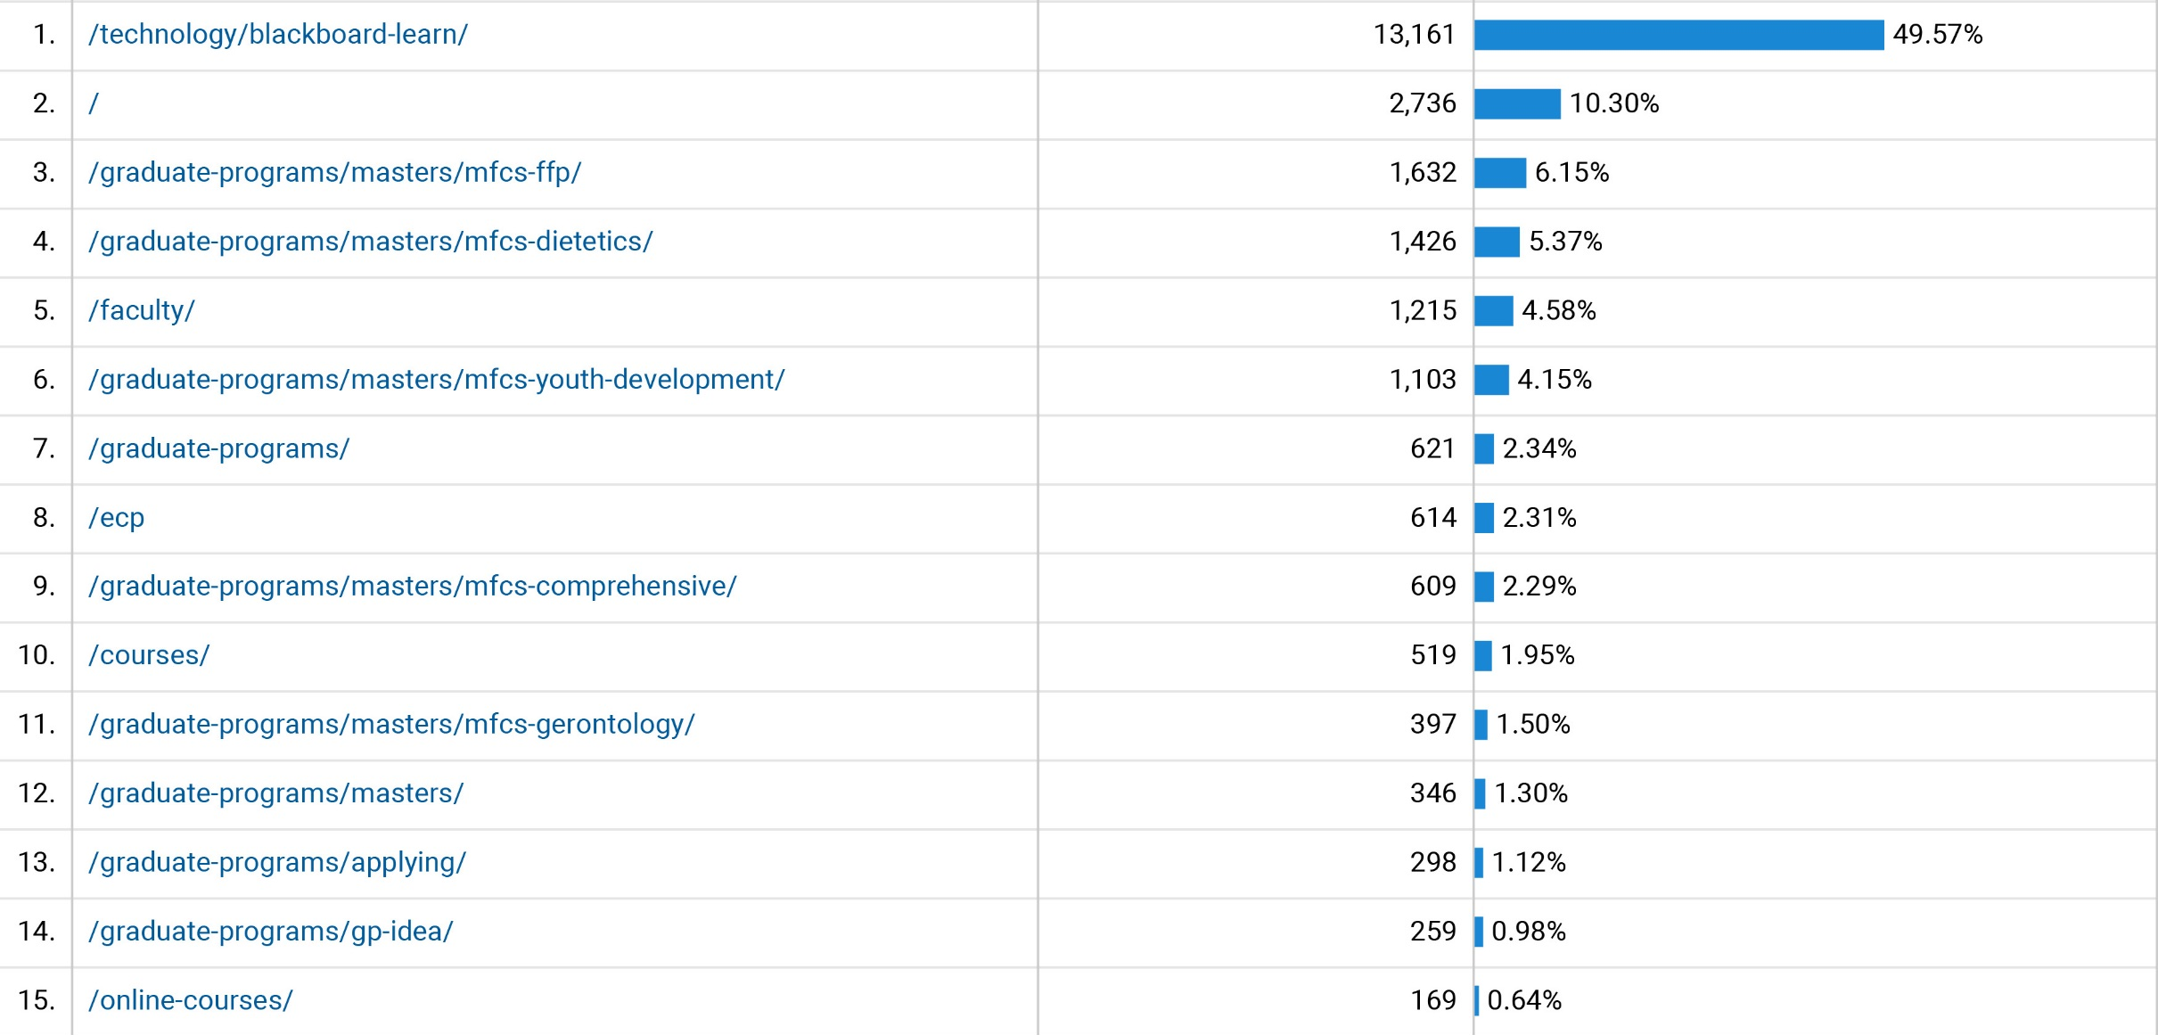
Online Landing Pages

Slide 10
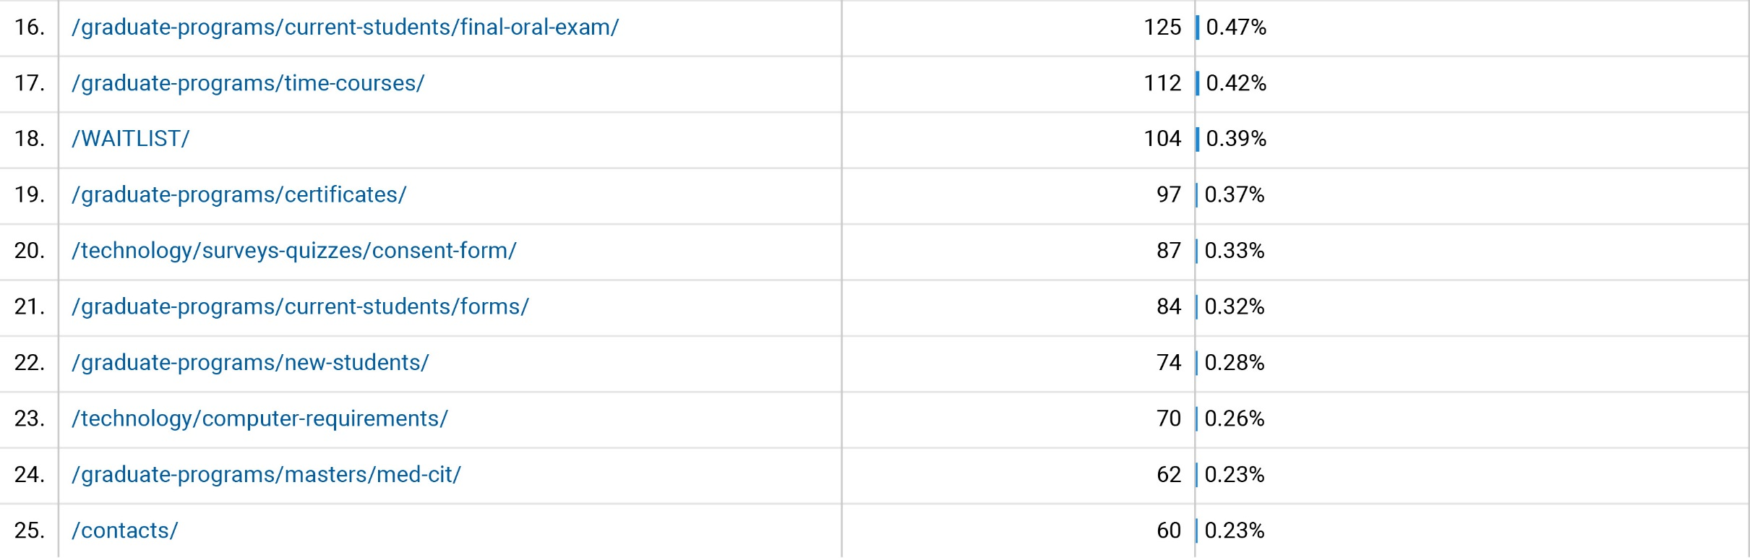
Online Landing Pages cont.

Slide 11
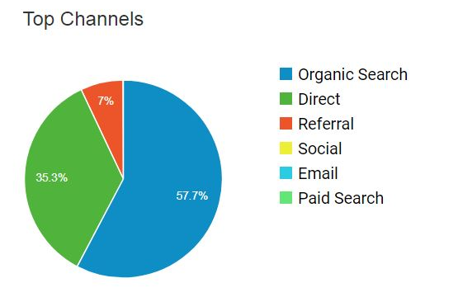
Online Visitor Acquisition

Slide 12
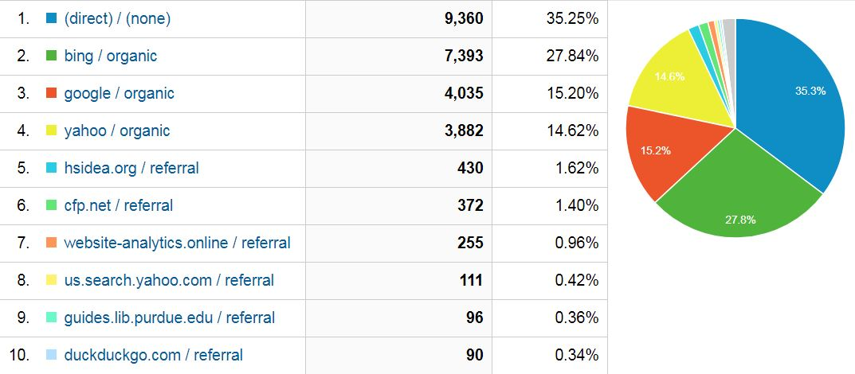
Online Visitor Acquisition

Slide 13
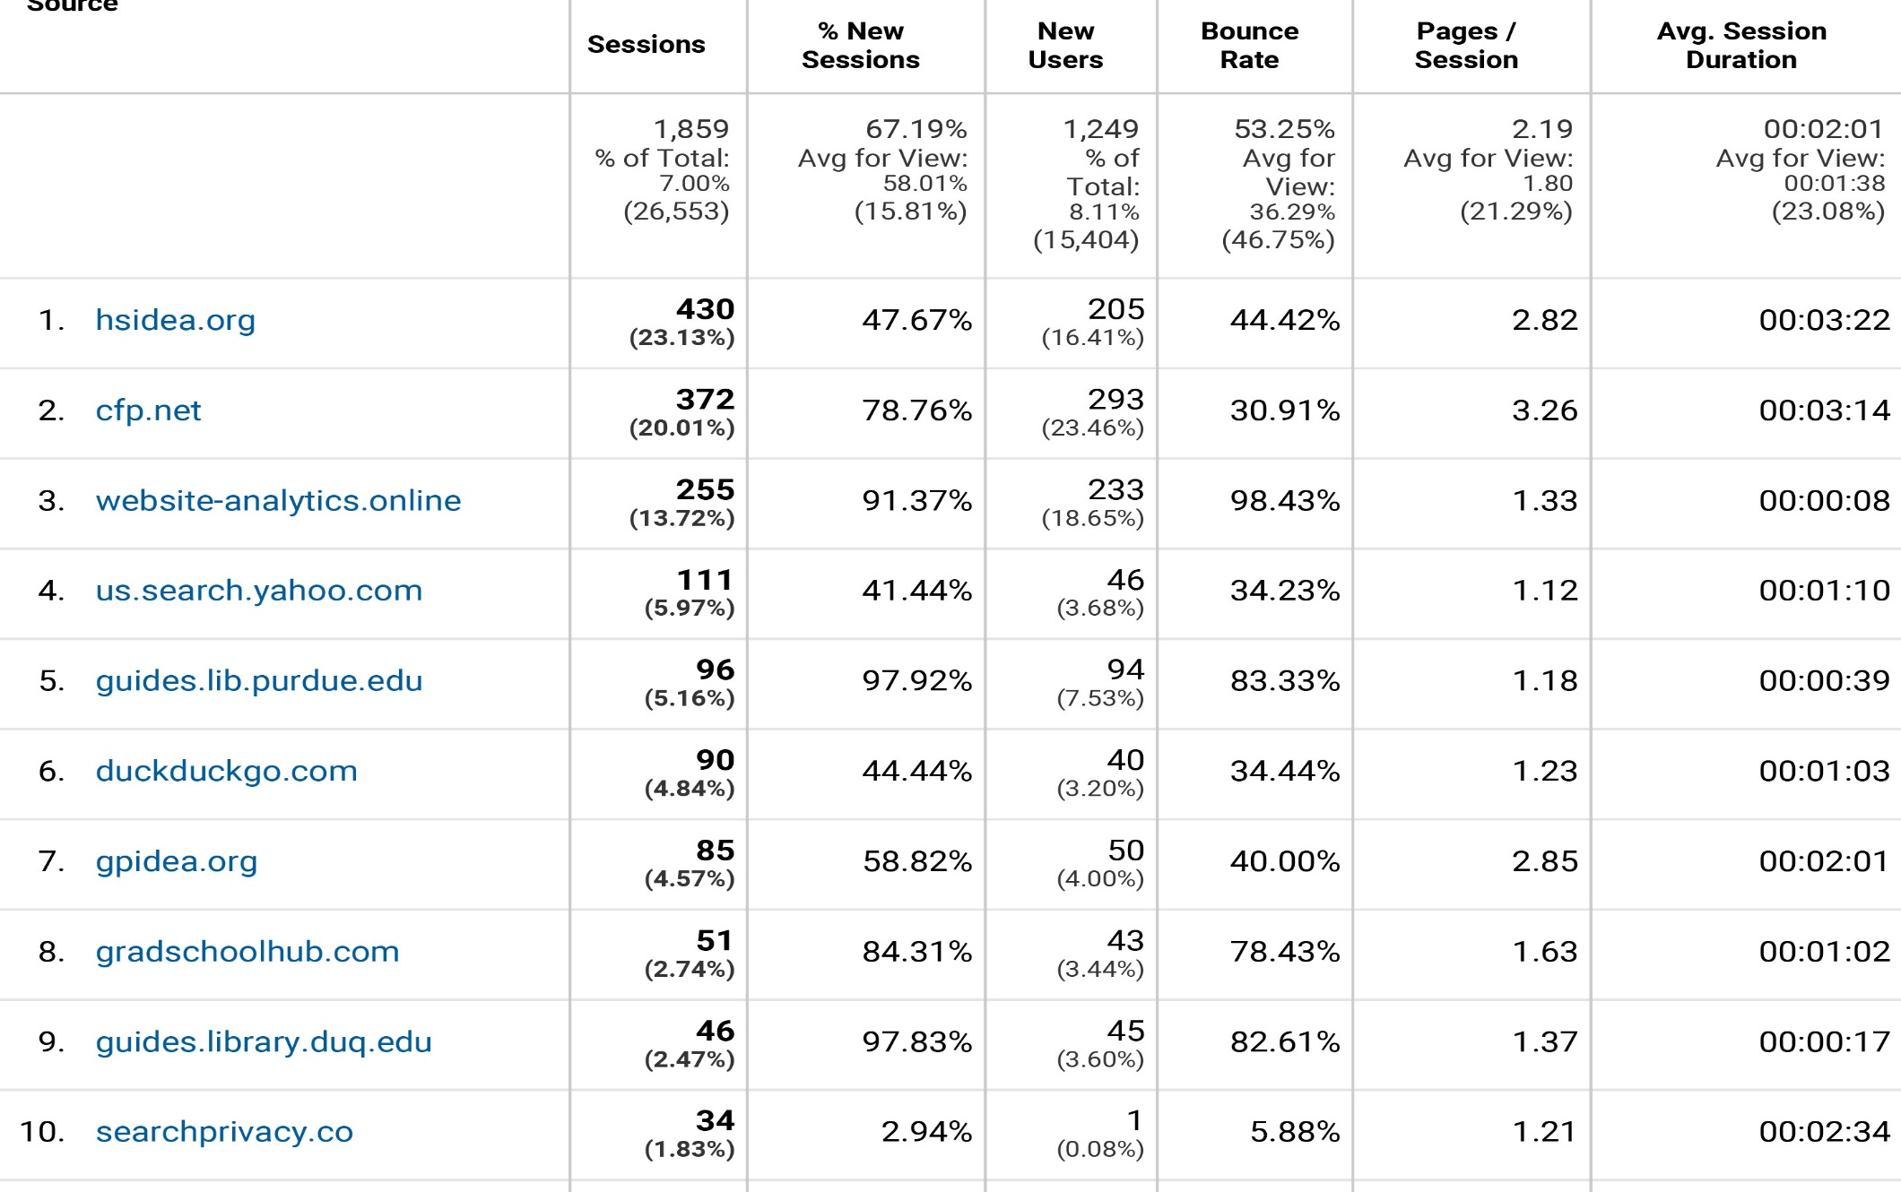
Online Visitor Referrals

Slide 14
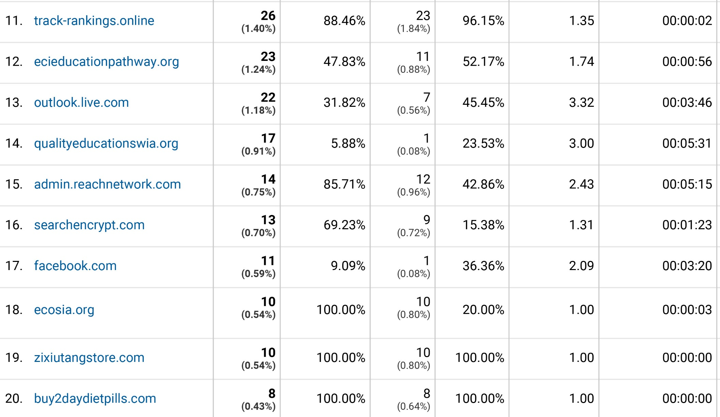
Online Visitor Referrals cont.

Slide 15
Online Least Visited Pages
1 http://www.online.hs.iastate.edu/graduate-programs/certificates/
2 http://www.online.hs.iastate.edu/graduate-programs/applying/?page_id=887
2 http://www.online.hs.iastate.edu/graduate-programs/current-students/degree-timeline/?page_id=916
3 http://www.online.hs.iastate.edu/graduate-programs/masters/mfcs-gerontology/?page_id=877
5 http://www.online.hs.iastate.edu/faculty/design/creatingsyllabus/
7 http://www.online.hs.iastate.edu/faculty/design/lessons/
10 http://www.online.hs.iastate.edu/ecp/5/
10 http://www.online.hs.iastate.edu/technology/surveys-quizzes/optimizing/ 12 http://www.online.hs.iastate.edu/technology/equipment/ 12 http://www.online.hs.iastate.edu/?sslsite=false 17 http://www.online.hs.iastate.edu/programs/ 20 http://www.online.hs.iastate.edu/technology/facilities/
21 http://www.online.hs.iastate.edu/h/technology/surveys-quizzes/participation-incentives/ 27 http://www.online.hs.iastate.edu/technology/surveys-quizzes/
34 http://www.online.hs.iastate.edu/tips-training
38 http://www.online.hs.iastate.edu/faculty/design/
41 http://www.online.hs.iastate.edu/faculty/teaching-technology/

Slide 16
Online Least Visited Pages
44 http://www.online.hs.iastate.edu/faculty/course-development/
47 http://www.online.hs.iastate.edu/technology/surveys-quizzes/processes/
60 http://www.online.hs.iastate.edu/waitlist/waitlist-fall-2017/
64 http://www.online.hs.iastate.edu/technology/software/
72 http://www.online.hs.iastate.edu/graduate-programs/current-students/graduate-committee/
78http://www.online.hs.iastate.edu/graduate-programs/current-students/transfer-credits/
102 http://www.online.hs.iastate.edu/technology/surveys-quizzes/consent-form/

